Slide 1
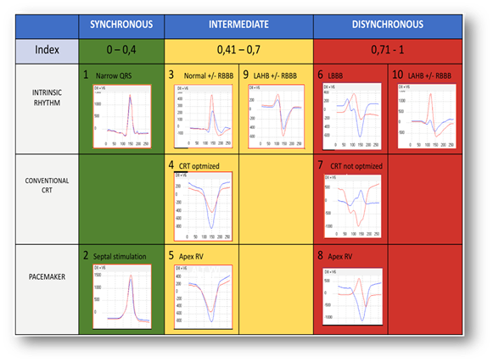
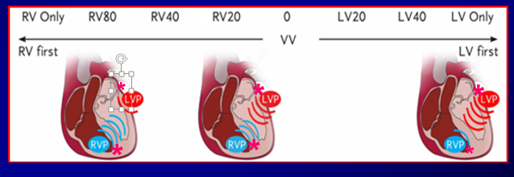
EP 1169
SYNCHROMAX II ® EVALUATION AND OPTIMIZATION OF ELECTRICAL DYSSYNCHRONY INDEX IN PATIENTS WITH CARDIAC RESYNCHRONIZATION THERAPY.
Ortega DF, Barja LD, Logarzo EA, Paolucci A, Mangani N, Aboy J, Revollo G.
Clínica San Camilo, Ciudad de Buenos Aires. FIBA.
INTRODUCTION: CRT is designed to achieve simultaneous contraction of the septum and LV lateral wall to avoid the deleterious effects of LBBB in patients with heart failure. At present there is not a "gold standard" method for CRT optimization. We present a noninvasive method for assessing cardiac electrical synchrony (Sy). The clinical application of this system in CRT allows a quick and noninvasive method to select the optimal interventricular interval (IVI) pacing.
OBJECTIVES: The aim of this study was the noninvasive evaluation and CRT optimization, determining characteristic curves and indexes allowing optimal setting of the IVI pacing.
METHODS: 30 p were retrospectively studied, 80% p were male, 27 p had dilated cardiomyopathy and LBBB, and the others (3) had complete AV block with narrow QRS, and received CRT with conventional lead in RVA. The left heart lead was placed in the coronary sinus in 27 pts; in the 3 p with complete AVB the lead was placed in septal position.
Electrical Synchrony was analyzed by Synchromax II ®. We determined the electrical synchrony index (ESI), electrical correlation curves and the IVI pacing in all patients and optimized it in relation to the best index and Synchrony curve obtained by Synchromax II ®.
RESULTS:
The baseline QRS averaged 163.2 msec (SD = 27.8). After optimizing the IVI the best QRS intervals achieved averaged 143.6 msec (SD = 21.58), with a statistically significant difference.
The average baseline ESI was 0.7 (SD = 0.36), while the average best index obtained after the electrical resynchronization was 0.31 (SD = 0.14), the difference being statistically significant.
84.7% of patients had a curve 7 with a baseline IVI pacing of 0 msec. After electrical optimized IVI equal to 0 msec were found in 6.7% of cases.
CONCLUSION: Electrical optimization of the IVI by this method is very simple and fast. It achieves a significant reduction in QRS duration, with improved ESI and curves. The distribution of optimal IVI in CRT suggests that this value is variable on each patient. “Nominal” parameters is not optimal in most cases.
Notes:
Example of patient with electrical resynchronization therapy where optimization of electrical synchrony was performed with Synchromax II. You can see the different curves and indexes to different interventricular pacing intervals. Note that the optimal curve with the best index is found when you pace the right ventricle earlier than the left ventricle at an interval of 20 msec

