Slide 1
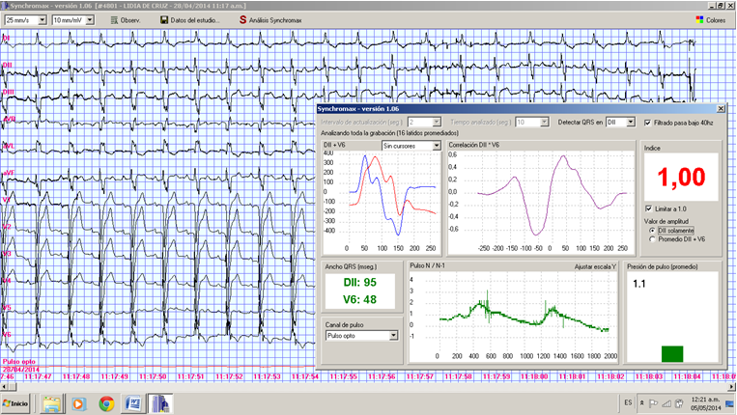
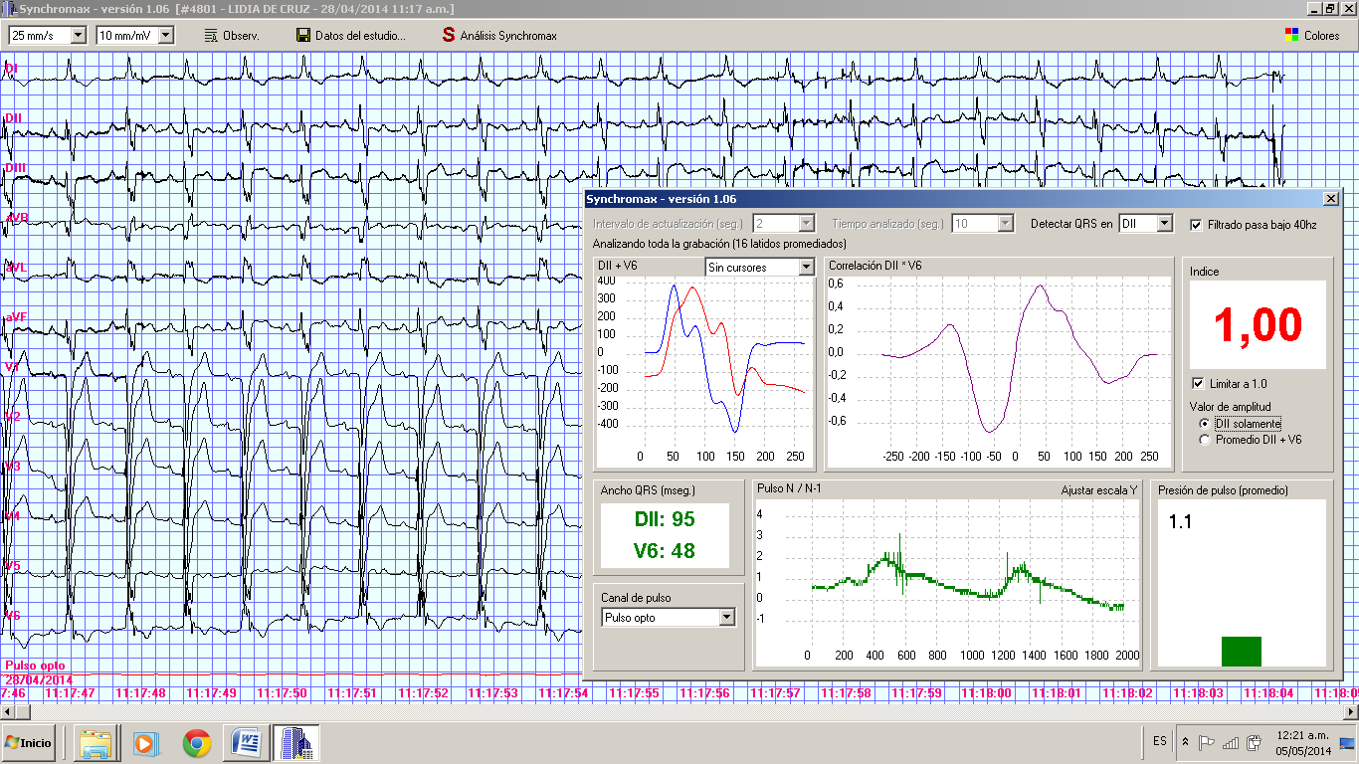
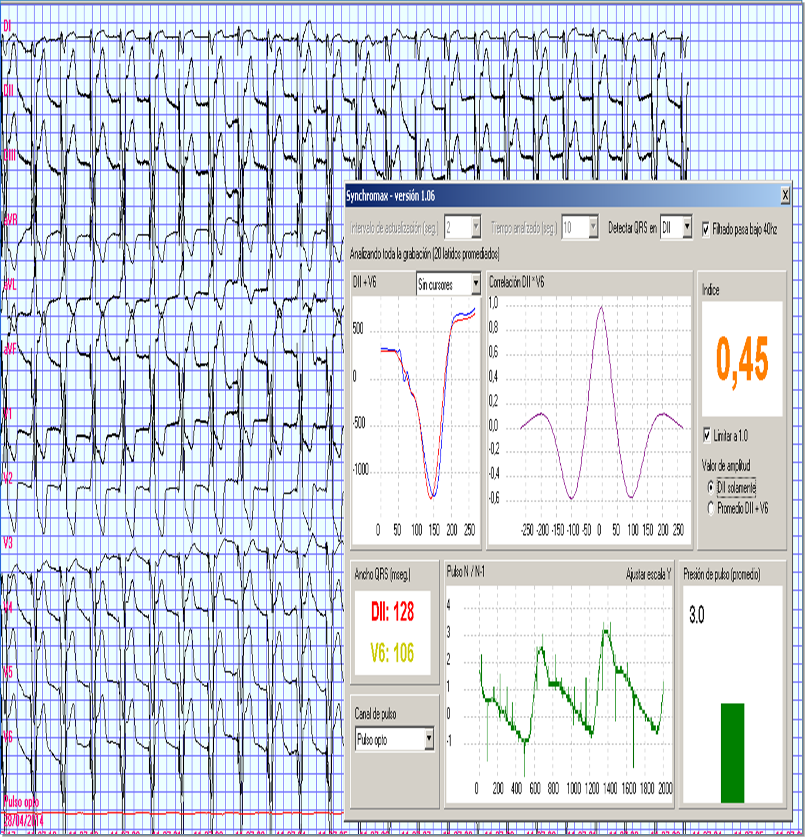
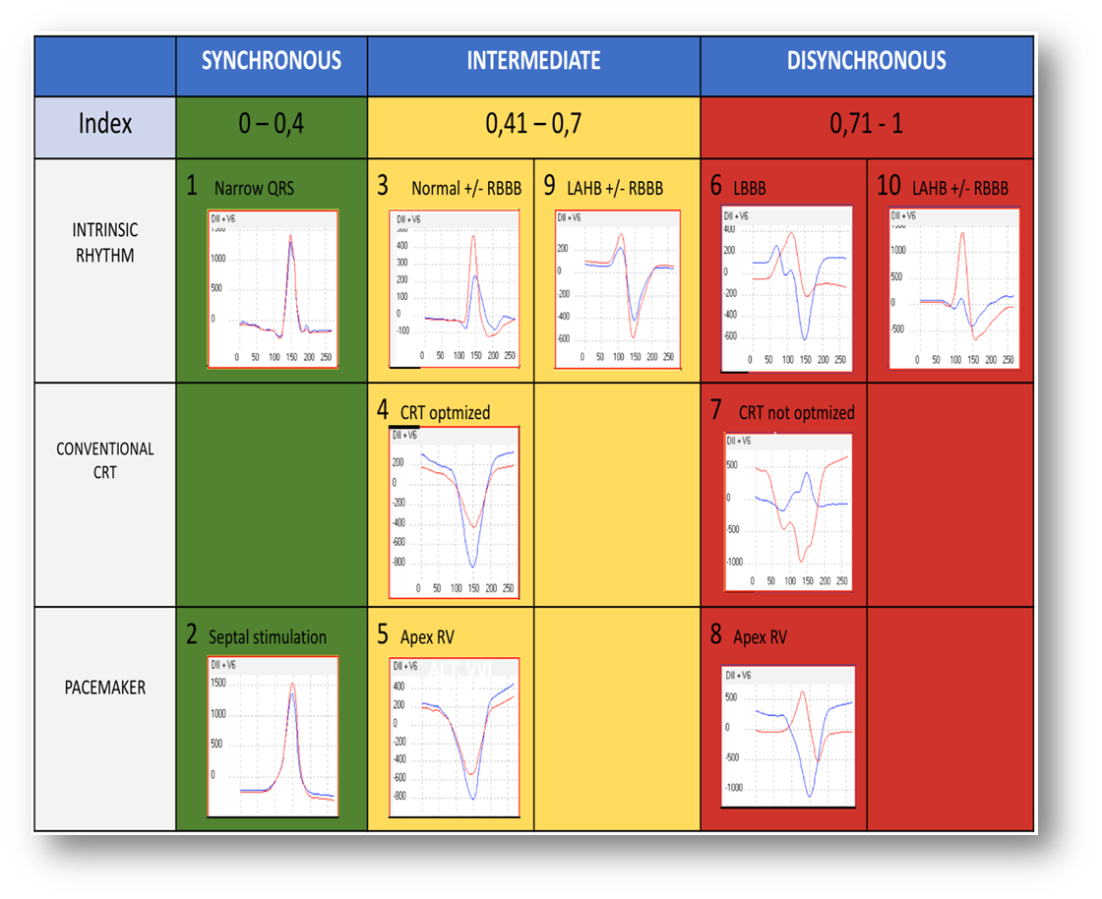
EP 1160
USEFULNESS OF VENTRICULAR SENSE RESPONSE IN LAST-GENERATION CRT DEVICES.
Ortega DF, Barja LD, Logarzo EA, Paolucci A, Mangani N, Aboy J, Revollo G.
Clínica San Camilo, Ciudad de Buenos Aires. FIBA.
INTRODUCTION: Last generation CRT devices incorporate a system to maintain biventricular pacing in patients with atrial arrhythmias exceeding the lower rate of stimulation. During these arrhythmias, the CRT device senses the right ventricular activity and triggers a biventricular spike without delay, with zero V-V interval. Synchromax II ® is a method designed to evaluate electrical synchrony through noninvasive ECG analysis variance.
OBJECTIVES: The objective of our study was to determine the electrical effects of this stimulation mode.
METHODS: 32 patients with last-generation CRT devices implanted.
All patients had intrinsic rhythm, complete left bundle branch block (LBBB) and preserved AV conduction. Baseline electrocardiogram was performed in all patients, as well as noninvasive synchrony index and curves using the Synchromax method. The QRS duration of baseline ECG, VVI pacing ECG and VSR (Ventricular Sense Response) pacing ECG were compared. In order to activate the VSR the devices were programmed in VVI mode with a lower rate than the intrinsic rhythm. The absence of P waves sensing activates the VSR mode.
Sinchromax II intrinsic rhythm Curve 6 dysynchronous.
INDEX 1,00
Sinchromax II. Stimulation VSR
Curve 6 dysynchronic.
INDEX 1,00
Sinchromax II. Optimized CRT stimulation
RV-LV 20. Curve 4. INDEX 0,45
RESULTS: The baseline QRS mean duration was 178 +/- 22 msec. 180 +/- 23 msec was observed in VSR mode. After CRT optimization mean QRS duration was 130 +/- 20 msec. Baseline QRS morphology and during VSR mode stimulation were the same. In all cases Curve 4 (optimal synchronization) and electrical synchrony Index (ESI) normalization were obtained.
CONCLUSION: In this group of patients, VSR mode did not produce effect on the electrical synchrony and QRS duration.

