Slide 1
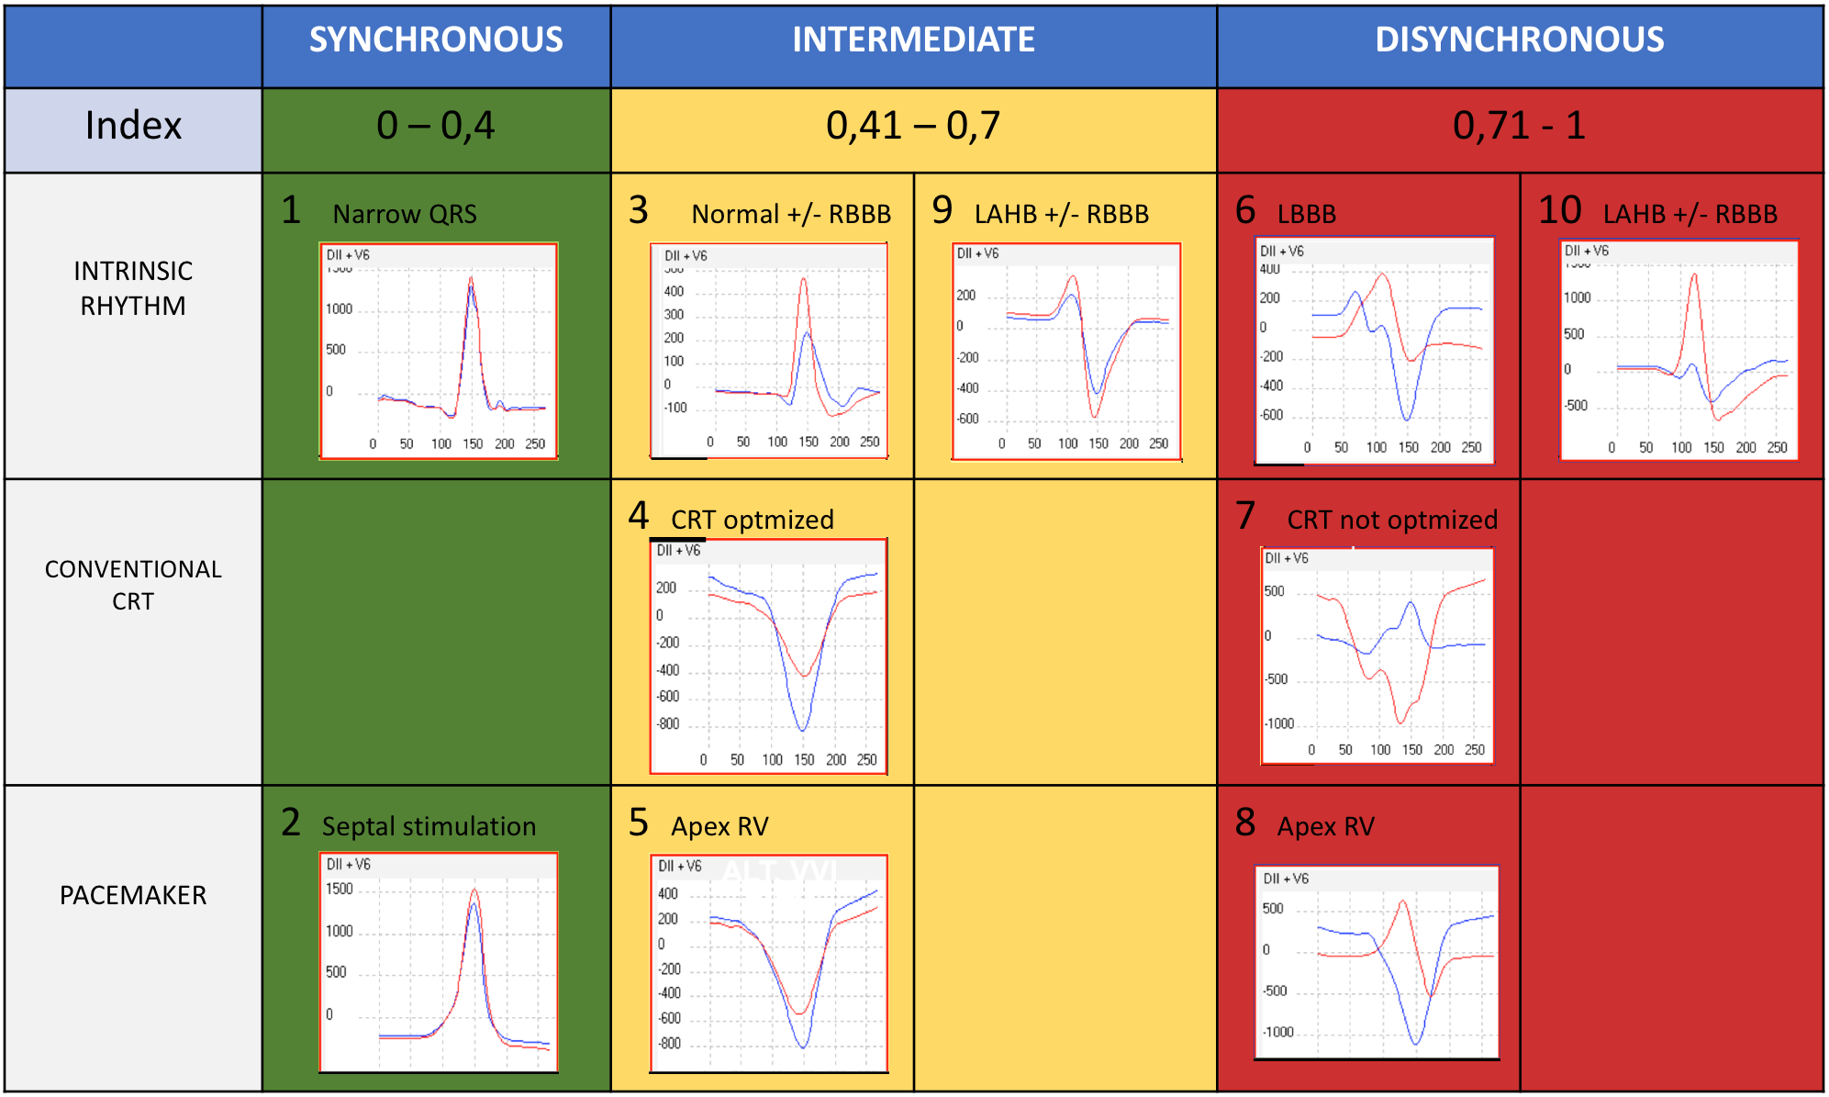
A novel non-invasive electrical synchrony method to improve cardiac resynchronization therapy responders
Authors: Logarzo Emilio ¹, Ortega Daniel ², Barja Luis¹, Paolucci Analía¹, Mangani Nicolás², Revollo Gerson², Aboy Juan² -
(1) Clinica San Camilo, Buenos Aires, Argentina (2) F.I.B.A., Buenos Aires, Argentina
#83136
Introduction: Cardiac resynchronization therapy (CRT) has emerged as an important treatment for patients with heart failure and reduced ejection fraction (EF) despite optimal pharmacological therapy. Some studies showed non-responders rate near 30%. Nowaday there is no gold standard method for selection, evaluation and follow up on this group of patients. Multiple techniques used and operator dependence made echocardiogram failed. Synchromax 2 is a device designed to evaluate non-invasive electrical synchrony. It is fast, reproducible and non-operator dependent. Synchromax was evaluated and correlated with other techniques in previous studies.
Objective: Evaluate CRT response rate guided by electrical synchrony during the device implantation and follow up.
Material and methods: 43 patients were evaluated in an institution in Buenos Aires. A ICD-CRT was implanted in all patients due dilated cardiomyopathy, low EF (less than 35%) and left bundle branch block (LBBB). Non-invasive electrical synchrony evaluation (Synchromax 2) was performed in all patients in baseline condition, during device implantation and the follow up. Synchrony index and curves were analyzed. Curve type 4 and index between 0,4 and 0,7 were considered synchronous. Curve type 6 and 10 and index more than 0.7 were considered disynchronous. Interventricular intervals were modified to achieve the best curve and synchrony index. Super responders were considered when EF increased >50%. Baseline and 6 month after implantation echocardiogram were performed.
Baseline clinical characterisctics
 | Patients (n=43)
Age | 64 years old
Ejection Fraction (%) | 27%
Most frequent curve | Type 6 (55,2%)
Index >0,7 | 73,3%
EF increased average | 38%(⇑12%)
Super responders rate | 18,6% (n=8)
Non-invasive electrical evaluation in a responder patient. Interventricular intevals are modified in order to achieve a type 4 curve with a index less than 0,7. Best curve was achieved with RV first 20 msec.
Etiology
 | Type 4 curve (n=28) | Non-type 4 curve (n=15)
EF baseline | 23% | 29%
EF follow up | 42% | 34%
Synchromax method shows different types of curves which are divided into three groups: Synchronous (index value betwen 0 and 0.4); intermediate (index value betwen 0.41 and 0.7); and dysynchronous (index value betwen 0.71 and 1). A type 2 curve is for parahisian stimulation.
Non-invasive electrical evaluation in a non-responder patient. Interventricular intevals are modified in order to achieve a type 4 curve with a index less than 0,7. In this case type 4 curve was not achieved.
Follow up EF increased. Comparison betwen synchronous group (type 4 curve achieved) and dysynchronous group (non-type 4 curve achieved).
Conclusion: Electrical synchrony evaluation using Synchromax 2 during ICD-CRT device implantation improves responders rate. When synchronous type 4 curve is achieved EF improves significantly. If type 4 curve is not found results will be unsuccessfully. Synchromax is fast, simple and non-operator dependent.

